Slide 1
Instrumentino Control your experiments
Joel Koenka
SCS Fall meeting 11/09/2014
Notes:
Hi, my name is Joel Koenka. I’m a second year PhD student in Uni Basel, doing analytical chemistry in the Hauser group.
In our group we build our experimental settings from scratch, and when a setting is ready, we need to write up a software to control it.
So about a year ago, I started developing a software framework that would fit all of our present settings and the ones to come.
I called it “Instrumentino”, as it’s a way to control “Arduino”-based instruments, and this is what this presentation is all about.

Slide 2

Experimental science
Notes:
Let’s say you’ve got an idea! A new way for doing something, no one has done ever done before.
That’s what science is all about, right?
The problem is –no one has ever done it before! You can’t just to to the store and buy an instrument!
You have to build it!

Slide 3
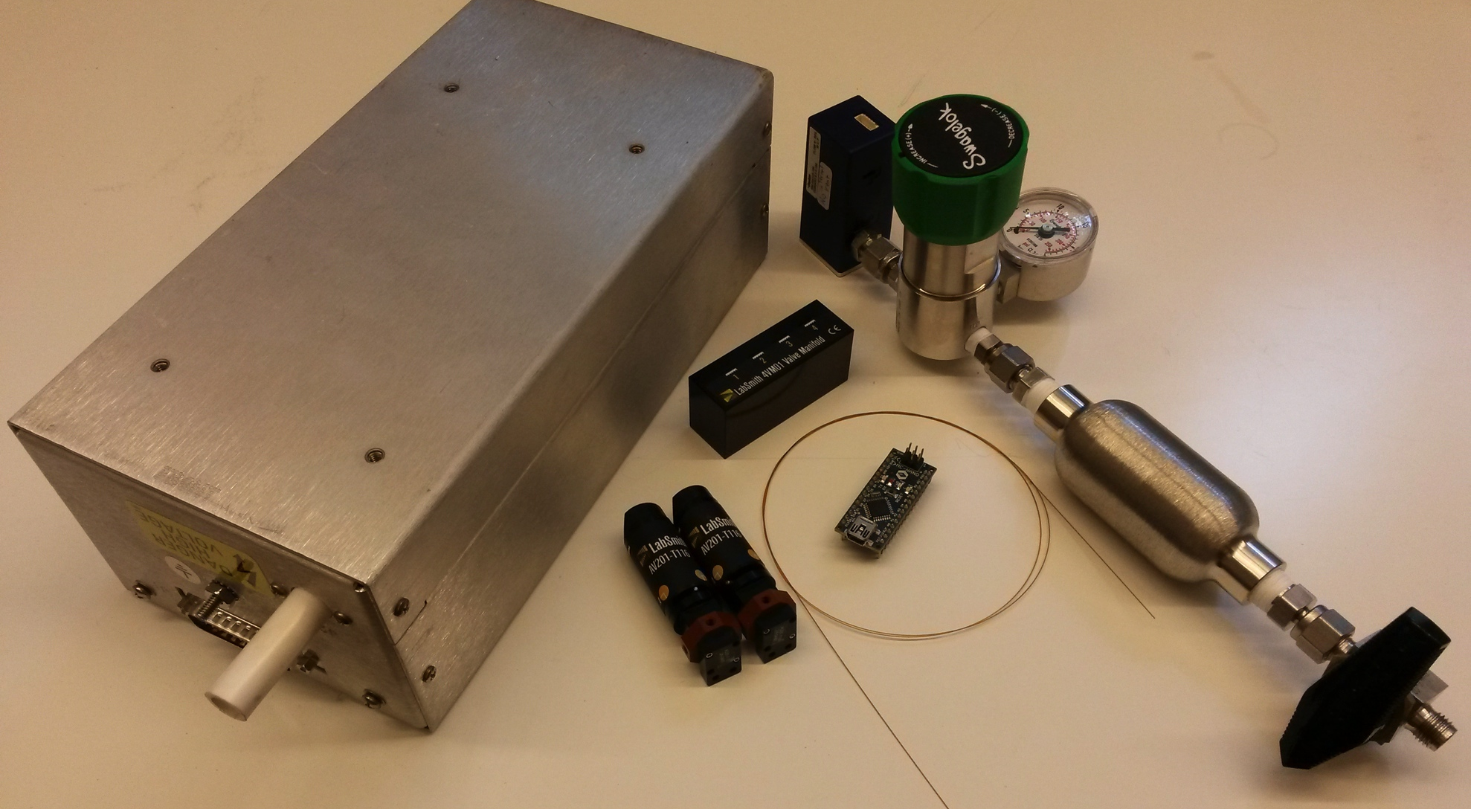
Purpose-made systems
Notes:
So you sit and think, sketch up a design, get the right parts and fit them all together.
And as it’s already 2014, the parts are most likely to be electrically controlled, so in order to start using them, you need to hook them up to your PC.
Now, most hardware units don’t just come with a USB, but rather with some kind of electrical connector. This needs to be mediated to a PC by some kind of hardware controller.

Slide 4
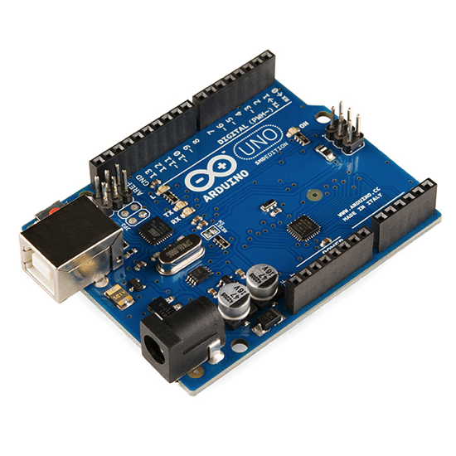

Arduino
An open-source hardware (OSH) microcontroller
Connects through a USB
Provides low-level control
Very easy to program
Very very cheap (~10 CHF)
Plenty of user experience on the web
Notes:
One type of hardware controller, that gained a lot of popularity over the last years - is using the Arduino.
An Arduino typically connects to a PC using a USB cable, and can be programmed very easily, to control all sorts of hardware units.
The control is done in the lowest level possible – meaning by setting voltages and currents to the right pins.
Arduino is an open-source hardware microcontroller, which means that all of the blueprints needed to create one are available online. From the card’s dimensions, through the electrical connections, to the code sitting in processor. It’s all there and free to use.
And on top of that, it’s very cheap! You can get a basic Arduino for about 10$.
Those that lack experience in electronics or programming can find plenty of guides and user experience on the web, which is very helpful.

Slide 5
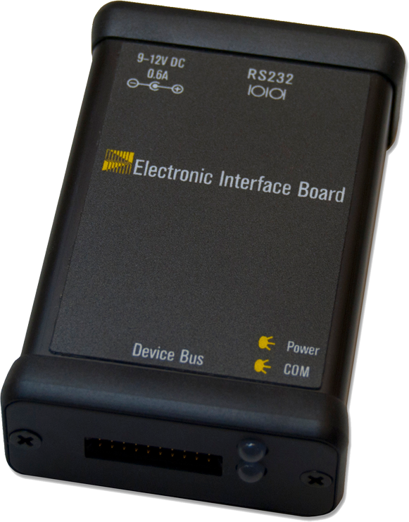
Proprietary controllers
Used to control sophisticated hardware units
Black box architecture
Comes with a dedicated software
Sometimes also provides an API (Application Programming Interface)
Notes:
There are, however, hardware units which are more difficult to control in such a low level. These usually need a proprietary controller, supplied together with them.
These are commercial products, so they have a black box architecture – meaning, you get a proprietary software, written by the company, that lets you control their hardware.
This is all ok, until you have an idea that is out of the box, and let’s say – you build a system that uses components form several companies.
Then you have two (or more) proprietary control programs that you need to run in parallel in order to control the whole system, and that’s not convenient at all.
Some manufacturers, however, are aware of this, so they provide an API (an application programming interface), which is a way for other programs to “speak” with the controller.

Slide 6
Control hierarchy
Notes:
The best would be if a single software could use these APIs to control the entire system, and orchestrate all of its components to conduct your experiment.

Slide 7
Software requirements
Control all of the system parts
Allow automatic run
Provide graphic on-line data on screen
Save data for later analysis
Run on all platforms (Windows, Mac, Linux)
Minimize user’s programming efforts
Notes:
Such a program would be also required to:
Run automatically
Provide relevant data on the screen, and save it for later use
And it would be nice if it would run on all platforms and be as simple to use as possible, so setting up a new system wouldn’t be a hassle
With that in mind, I we set out to write our new control software framework: Instrumentino

Slide 8

Presenting: Instrumentino
Does all of the above
Open-source, released under GPLv3
Written in python
Efforts = Design + Hardware + Software
Notes:
Instrumentino is an open-source (and free of charge) software platform for creating custom made GUIs for experimental systems.
It’s written in Python, which is a very common and high-level programming language, so it’s relatively easy to master.
Though there are similar commercial solutions such as LabView, they tend to be very expensive, and sometimes difficult to handle.
And a year after we’ve started developing it, it’s easy to see it was worth the effort.
By using Instrumentino in our group, we basically took the software development efforts out of the equation.

Slide 9



Levels of engagement
End user: Run experiments
Advanced user: Set up new systems
Fellow developer: Add features
Notes:
Instrumentino is released along with its source code, so users with different levels of expertise can interact with it.
Normal users will simply use the GUI to run their experiments, as in any commercial system.
Advanced users can write the description files for newly built experiments
And fellow developers can add new features and capabilities to Instrumentino, making it better for everyone.

Slide 10
Required programing effort
Notes:
One important aspect that guided us was to make Instrumentino as easy as possible to use.
Potential users are students that are required to build new experimental setups, who not necessarily have such a broad background in programming.
This is why we internalized most of the programming effort inside Instrumentino. Newly built systems need only to have a short python file to describe them.
In it, the components of the systems are described by Python classes, and a set of meaningful actions follow (and some wrapping code to make it all work together).

Slide 11
Example: Capillary Electrophoresis (CE)
Components:
High-Voltage supply
Pressure controller
Valves
Syringe pump
Actions:
Flush capillary with buffer
Inject sample
Start a separation
Methods (lists of actions):
Separate sample 1 with 20 kV
Separate sample 2 with -30 kV and co-flow
etc…
Notes:
For example, let’s think of a simple Capillary Electrophoresis (CE) system.
You need a high voltage supply, a pressure regulator, some valves and a syringe pump.
Relevant actions would be: to flush the capillary with buffer, inject a sample, and start a separation.
Using these actions, you can them define experimental methods for a whole separation.
This is the only thing needed – and Voila! A custom made GUI to run your experiments.

Slide 12
Graphical User Interface
Notes:
The user interface is divided to three logical parts.
On the left there is a list of components, and means to directly control and observe their relevant values (for example: a pressure controller would have a text box with the pressure it outputs)
In the middle, there’s a panel to control your set your run flow: Lists of actions (which are called methods), that can be saved and used later.
These methods can be bundled up (using the second tab) to create long run sequences, and you can let your system run for days, uninterrupted.
If something goes wrong, you can always press the big red STOP button ☺.
On the right, there is a logging panel, showing the relevant system signals over time. On the same panel there’s also a tab that records the user’s actions. Kind of a log file.

Slide 13
Case studies
Some systems already using Instrumentino
Notes:
This, in a nutshell is Instrumentino
I could go over in more details into the user interface and the way the software is built, but this is fitting to a longer talk.
Instead, in the last few minutes I’d like to cover some of the projects we’ve already made in our group – using Instrumentino
* Not all projects are shown. For more information, contact the Author

Slide 14
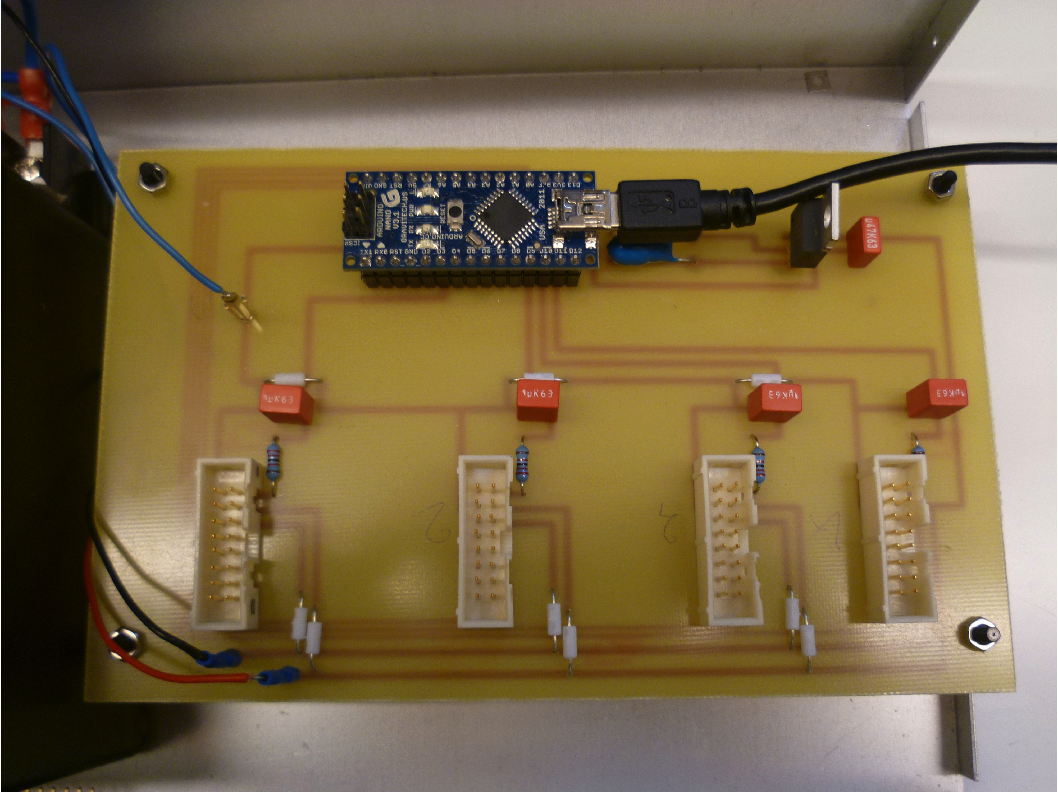
Low-cost MFC control box (Mass Flow Controller)
Notes:
A very common piece of equipment you find in research labs is the Mass Flow Controller.
You could buy an MFC control box for a few hundreds or even thousands francs, or you could build it alone, like we have done, and pay around 50 francs.
Using this box, you can automatically control 4 MFCs using Instrumentino.

Slide 15
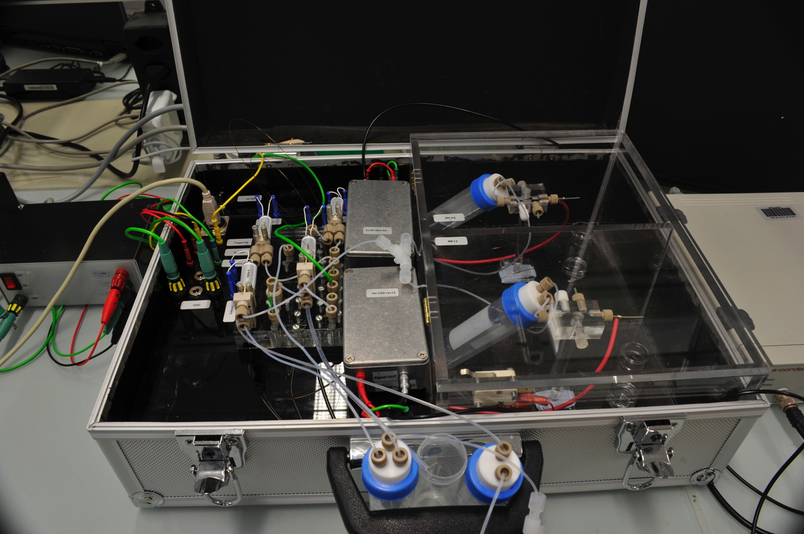
Portable dual-capillary CE
Collaboration:
Dr. Jorge Sáiz, Prof. Carmen García-Ruiz
Department of Analytical Chemistry, Physical Chemistry and Chemical Engineering
University of Alcalá, Madrid, Spain
Notes:
In our group we do a lot of CE, in many variations.
During his PhD, Dr. Jorge Saiz was a joint student of Prof. Hauser in Basel and Prof. Garcia-Ruiz in Madrid.
Together with him we’ve developed several CE systems for different purposes.
One of them is the portable dual-capillary CE, for the simultaneous analysis of anions and cations.
It was used for determining inorganic ions in consumer fireworks

Slide 16
Thank you for listening
Interested in a collaboration?
Contact: joel.koenka@unibas.ch
Notes:
Thank you for listening. If you found Instrumentino might help in your research, please contact us – we’re looking forward for future collaborations.

